Slide 1


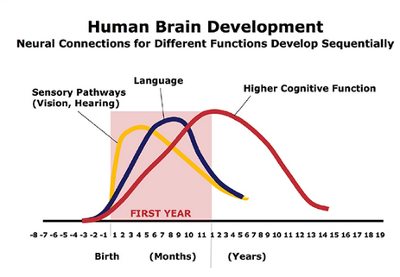


How Does The IPhone/IPad Affect Children From 1 To 15 Years In UAE
Your Name And The Names Of The People Who Have Contributed To This Presentation Go Here.
Abstract
Methodology
Findings/Results
Discussions/ Conclusions
The purpose of the research was to determine the relationship between the use of iPhone/iPads and child’s development. The results showed that using these devices would bring negative impacts on children between 1 to 15 years old.
Materials/Methods/ Procedure
Materials: Statistical software (like excel) to record and analyze data
Independent Variable (IV): Number of children affected by use of iPhones/iPads
Dependent Variable (DV): Frequency of using iPhones/iPads (number of days per week)
Control: Number of children not using the devices
Experiment/process: Conducted one sample t test to compare means the control group and the affected group of children. Difference in the means indicated the presence of impacts.
The experiment worked since there was a difference of means between the two groups. The null hypothesis was rejected since there was sufficient evidence to indicate the relationship.
Findings & conclusion
Since the p value for the mean difference was significantly small (less than significance level of 0.05), there was enough evidence to show that the relationship between child development between 1 to 15 years of age and the use of iPhones/iPads exists.
IPhones/iPads have negative effects on child’s development. Their use of the devices should be regulated by parents to protect them from interfering their growth due to electronic emissions from the devices.
Introduction
Research question: Is there any relationship between academic development and the use of iPhone/iPads among children from 1 to 15 years in UAE (Koch, 2011)?
Hypothesis:
H0: iPhones/iPads have no effect on child’s development (Donnelly & Abdel-Raouf, 2016)
H1: iPhones/iPads have effect on child’s development ("Using mobiles and tablets at bedtime is bad for children's health", 2018)
(Figure 7)
References
Donnelly, R., & Abdel-Raouf, F. (2016). Statistics. Indianapolis, Indiana: Alpha, a member of Penguin Random House LLC.
Koch, K. (2011). Parameter estimation and hypothesis testing in linear models. Berlin: Springer.
Using mobiles and tablets at bedtime is bad for children's health. (2018). Mail Online. Retrieved 24 February 2018, from http://www.dailymail.co.uk/sciencetech/article-3882746/Streaming-instead-dreaming-Using-phones-bed-stops-kids-sleeping-lead-health-issues.html

